Slide 1


HADOOP DISTRIBUTED FILE SYSTEM - HDFS

Slide 2

Program
Sequence of instructions written to perform a specified task with a computer
Process
an instance of a computer program that is being executed.
or a execution of a program
Daemon Process
Process which runs in background and has no controlling terminal.
JVM – Java Virtual Machine
Program which executes certain programs, namely those containing Java bytecode instructions
2

Slide 3
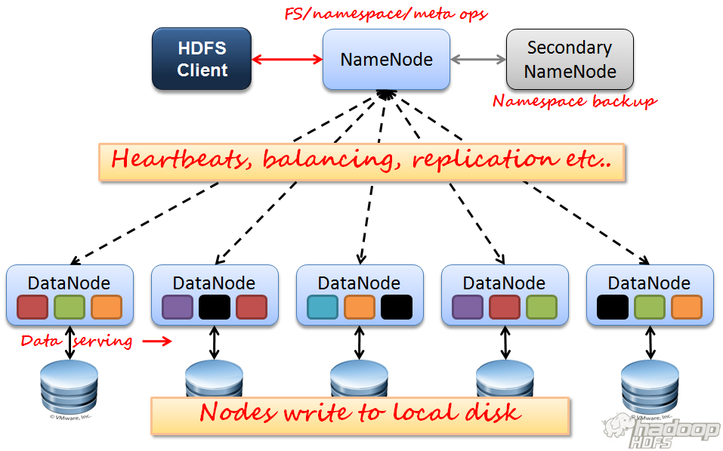
HDFS ARCHITECTURE

Slide 4

Client-server Concept
Client sends requests to one or more servers which in turn accepts, processes them and return the requested information to the client.
A server might run a software which listens on particular ip and port number for requests
Examples:
Server - web server
Client – web browser
4

Slide 5

A distributed File System - STORAGE
Hardware Failure
Due to usage of Commodity machines, failure is a common phenomenon
Designed for failure
Large Data Sets
Small Files Problem Due to NameNode
Simple Coherency Model
Write Once , Read Many Times
Streaming Data Access
High Throughput instead of low latency access
5

Slide 6


NameNode Process
Application Code
Client Code
RPC
DATANODE
Process
DATANODE
Process
DATANODE
Process
6

Slide 7
NameNode Process
Namenode
dfs.name.dir
Application Code
Client Code
RPC
DATANODE
Process
DATANODE
Process
DATANODE
Process
Local FileSystem directories
dfs.data.dir
dfs.data.dir
dfs.data.dir
7

Slide 8

NameNode
DataNode
Secondary NameNode*
JobTracker*
TaskTracker*
8

Slide 9

TestFile1.txt Block Size
-> 1GB
-> 64 MB
Files are split into number of
chunks(Blocks) of pre-defined size
No of Blocks = 1GB / 64MB = 16 blocks Blocks are B1,B2,…..B16
DataNode
DataNode
DataNode
DataNode
B1 | B3 | B4 | B2
B8 | B7 | B5 | B6
B10 | B12 | B11 | B9
B13 | B16 | B14 | B15
9

Slide 10
What happens to my data if
TestFile1.txt Block Size
-> 1GB
-> 64 MB
node 4 goes down??
No of Blocks = 1GB / 64MB = 16 blocks Blocks are B1,B2,…..B16
DataNode
DataNode
DataNode
DataNode
B1 B8 B10 B13
B3 B7 B12 B16
B4 B5 B11 B14
B2 B6 B9 B15
10

Slide 11

HDFS provides fault tolerant by
HDFS provides fault tolerant by
replication of each block by 3
TestFile1.txt Block Size
-> 1GB
-> 64 MB
replication of each block by 3
No of Blocks = 1GB / 64MB = 16 blocks Blocks are B1,B2,…..B16
DataNode
DataNode
DataNode
DataNode
B1 B2 | B1 | B2 | B1 B2
B3 |  | B3 | B3
B4 . | B4 . | B4 . | .
. | . | . | .
. | . | . | .
11

Slide 12

Client
DataNode
DataNode
DataNode
B1 B2 | B1 | B2 | B1 B2
B3 |  | B3 | B3
B4 . | B4 . | B4 . | .
. | . | . | .
. | . | . | .

Slide 13

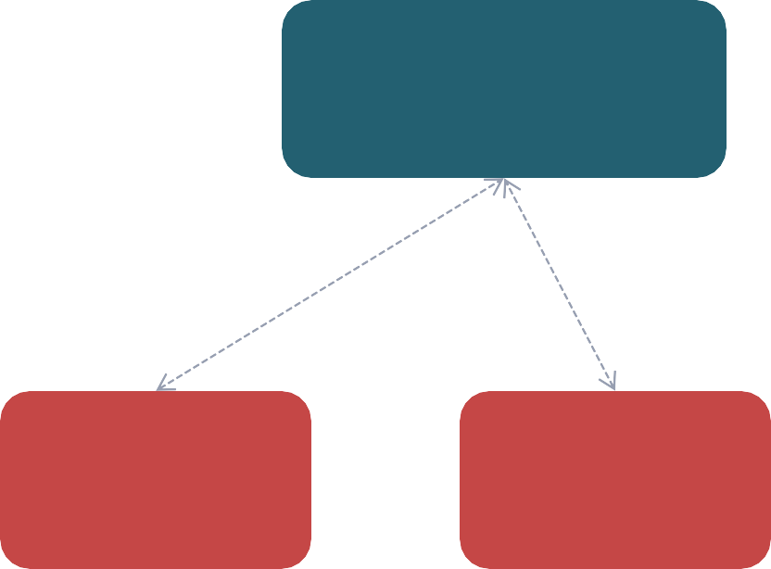
Stores the metadata (info about the files and blocks)
File Management(contains the metadata)
Block and Replica Management
Health of datanodes through block reports
NameNode
DataNode
DataNode
DataNode
DataNode
B1 B2 | B1 | B2 | B1 B2
B3 |  | B3 | B3
B4 . | B4 . | B4 . | .
. | . | . | .
. | . | . | .

Slide 14

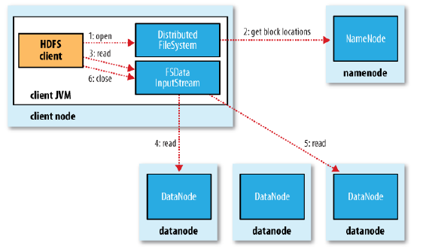

Slide 15

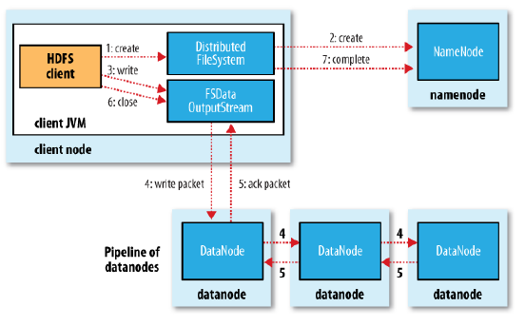

Slide 16

Modes
Single Stand Alone
All Process runs in a single jvm
Does not use HDFS
Pseudo Distributed Mode - Training Purpose
All daemon process runs in separate jvm in a single local machine
Used for development and testing
Uses HDFS to store data
Distributed Mode
A cluster of nodes more than 1
Each Process may run in different nodes

Slide 17
WEB UI ADDRESS
jps
Jps - jvm profiling status tool
Web UI
NameNode - http://localhost:50070
JobTracker – http://localhost:50030

Slide 18

Command line
Usage: hadoop dfs <command>
JAVA API
webHDFS

Slide 19

hadoop dfs -copyFromLocal <srcLOCALfile>
<destHDFSfile>
hadoop dfs -ls /
hadoop dfs -cat /<destHDFSfile>
hadoop dfs -copyToLocal <srcHDFSfile>
<destLOCALfile>
hadoop dfs -mkdir /test
hadoop dfs –rmr /test

Slide 20

append()
copyFromLocalFile()
create()
delete()
mkdirs()
open()

Slide 21

A helper node for NameNode
Performs memory-intensive administrative functions for the NameNode
Have a checkpoint for the file system (HDFS)
Not a Backup Node

Slide 22

Query For Edit Logs in regular intervals
NameNode Process
Secondary NameNode Process
Updates fsimage with edit logs
Copy the updated fsimage back to namenode
fsimage
fsimage

Slide 23
KEEP LEARNING ☺
RRR

